Slide 1
Chapter 1 Encryption & Spread Spectrum Techniques

Slide 2
Table of contents
01
02
03
04
05
06
Introduction to encryption
Symmetric encryption
Asymmetric encryption
watermarking
Spread spectrum
PN codes

Slide 3
01
Why encryption ?
Encryption is the vital technology to protect information and ensures the security of the communication in today’s digital landscape.
Encryption is the process of converting plain text into cipher text using an algorithm and an encryption key.
The cipher text is not intelligible without the corresponding decryption key.
Encryption keeps the data confidential and secure from any unauthorized access.

Slide 4
02
Symmetric encryption
Symmetric cryptography is a system where the same key is used for both
encryption and decryption of messages.
This key must be kept secret between the communicating parties to maintain the confidentiality of the information.

Slide 5
03
Symmetric encryption types
Block ciphers.
Stream ciphers.

Slide 6
04
Symmetric encryption example
symmetric encryption algorithm that encrypts and decrypts data using the same key.
Like DES,AES and Vigenère cipher

Slide 7
05
Advantages | Disadvantages
High speed High efficiency simplicity | Challenging key distribution Practically unscalable Hard key management

Slide 8
06
Asymmetric encryption
Asymmetric cryptography, public-key cryptography, is a cryptographic system that uses a public key and a private key.
This approach allows for secure communication and data exchange even over untrusted networks.
Public key : A key that can be distributed openly and used by anyone to encrypt a message or verify a digital signature.
Private key : A key that is kept secret by the owner and used to decrypt messages or create digital signatures.

Slide 9
07
Advantages | disadvantages
High Security. Good scalability. Digital signature. Versatile. | Computational intense. Key length. Complexity.

Slide 10
08
Watermarking
A watermark is a recognizable pattern or image embedded into a document,
photograph, video or other media which can be seen or detected to verify authenticity and ownership.
Watermarks can be visible or invisible.
Watermarks ensures the protection of digital assets against unauthorized use or duplication.

Slide 11
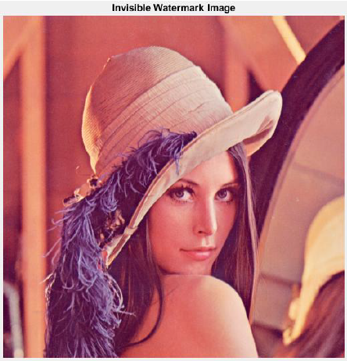
09
Watermarks types
Visible watermarks.
Invisible watermarks.
Fragile watermarks.
Robust watermarks.
Spatial watermarks.
Frequency-domain watermarks.

Slide 12
10
Advantages | disadvantages
Protection of intellectual property. Deterrence of Unauthorized Use. Verification of Authenticity. Tracking and Monitoring. Brand Recognition. | Quality Degradation. Complexity of Implementation. Vulnerability to Removal. Impact on User Experience.

Slide 13
11
Spread spectrum techniques
Spread spectrum is a communication technique that spreads a signal over a wider bandwidth than necessary for transmitting the data, using a specific code.
This enhances resistance to interference, improves security and enables multiple users to share the same frequency band.

Slide 14
12
Types of spreading codes
Orthogonal codes : Walsh codes.
PN codes : M-sequence, Gold codes.

Slide 15
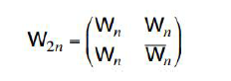
13
Walsh codes
Walsh code typically refers to a set of binary sequences used in
telecommunications and signal processing. These codes are often used in
communication systems, such as CDMA (Code Division Multiple Access) in
mobile networks.

Slide 16
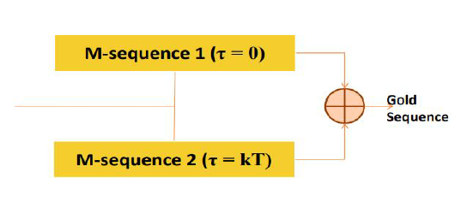
14
PN codes
PN codes spread the signal across a wide frequency band, providing multiple users with the ability to share the same frequency spectrum without interference.
It is generated by feedback shift registers or mathematical algorithms.

Slide 17
15
Properties of PN codes
Randomness.
Balanced.
Run property.
High auto-correlation.
Low cross-correlation.
Linear.

Slide 18
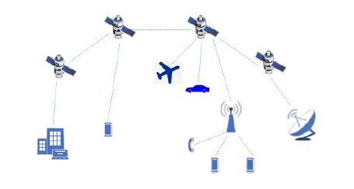
16
GPS
Global Positioning System (GPS), Precise satellite-based navigation and location system originally developed for U.S. military use.
GPS is a fleet of more than 24 communications satellites that transmit signals globally around the clock.

Slide 19
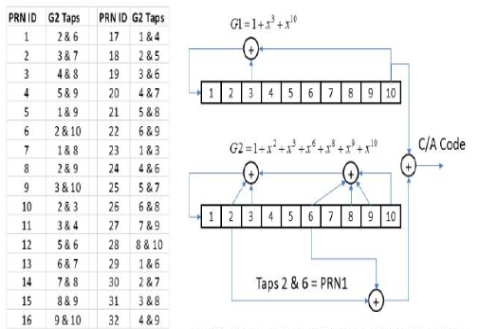
17
GPS C/A Code

Slide 20
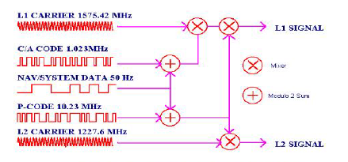
18
P Codes
A P-code (Precise code) is a code used in GPS signals for military purposes to provide a more precise level of accuracy than the civilian C/A code (Coarse/Acquisition code).

Slide 21
Chapter 2 Image Steganography

Slide 22
Table of contents
01
02
03
04
05
Introduction
Steps
Results
Attacks
Analysis Attacks

Slide 23
01
Introduction

Slide 24
In this Project
A secure steganographic algorithm based on cover image encryption and Vigenère cipher is proposed.
Where the secret message is encrypted using Vigenère cipher then the cover image is encrypted using the logical XOR operation.
After that, the encrypted form of the ciphered message is embedded within the encrypted cover image using the LSB algorithm.

Slide 25
02
Steps

Slide 26
Steps
At Transmitter
At Receiver
Read Image
Enter Text message
Encrypt Image (First Key)
Encrypt Text message (Second Key)
Embedding Encrypted Text in Encrypted Image
Decrypt Image
Send stego image
Use The First key to Encrypt
Stego image
Extract Encrypted Text message
from Encrypted Image
Use The Second key to Decrypt
Text message
Get Text message

Slide 27
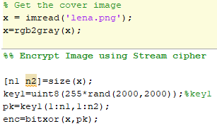
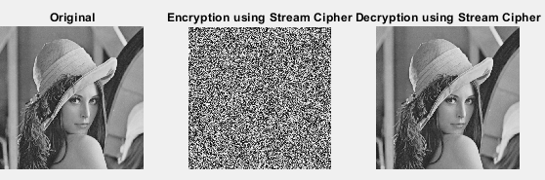
Image Encryption
The cover image is encrypted using the logical XOR operation Called Stream Ciphere

Slide 28
Text message Encryption
Text message is encrypted using Vigenère cipher
The Vigenere cipher is a polyalphabetic substitution cipher in which each letter of the alphabet is replaced with a different letter according to a table of ASCII.
Example for table of ASCII
A | 0 | H | 7 | O | 14 | V | 21
B | 1 | I | 8 | P | 15 | W | 22
C | 2 | J | 9 | Q | 16 | X | 23
D | 3 | K | 10 | R | 17 | Y | 24
E | 4 | L | 11 | S | 18 | Z | 25
F | 5 | M | 12 | T | 19
G | 6 | N | 13 | U | 20

Slide 29
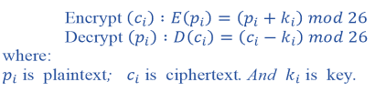
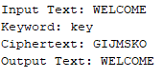
Example for Vigenère cipher
W | E | L | C | O | M | E
22 | 4 | 11 | 2 | 14 | 12 | 4
K | E | Y | K | E | Y | K
10 | 4 | 24 | 10 | 4 | 24 | 10
22+10-26=6 | 4+4=8 | 11+24-26=9 | 10+2=12 | 14+4=18 | 12+24-26=10 | 4+10=14
G | I | J | M | S | K | O

Slide 30
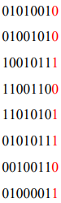
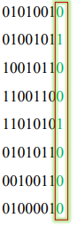
Least Significant Bit (LSB) Technique
Is a basic method for inserting data of the message in the LSB of the image.
Suppose the first eight pixels of the original image have the values
To hide the letter H whose binary value of ASCII code is 01001000 , we would replace the LSBs of these pixels to have the following new values:

Slide 31
03
Results

Slide 32
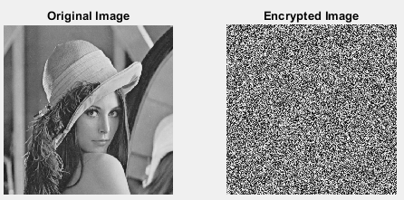
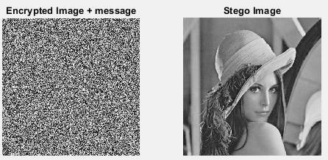
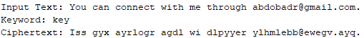
Results
At Transmitter

Slide 33
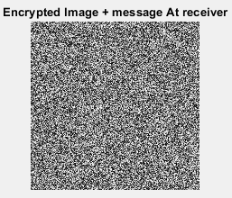
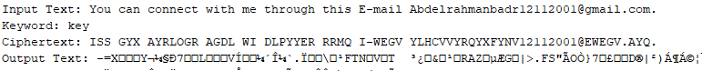
Results
 | MSE | PSNR | Corr
Original and Stego | 7.7820e-04 | 181.6105 | 1
At Reciever
Receiver can’t receive text correctly without encrypting image.

Slide 34
04
Attacks

Slide 35
Attacks
Crop Image
Salt & Pepper Noise
Gaussian Noise

Slide 36
05
Analysis Attacks

Slide 37
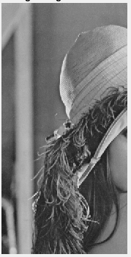
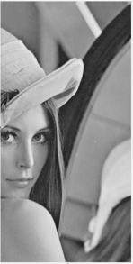
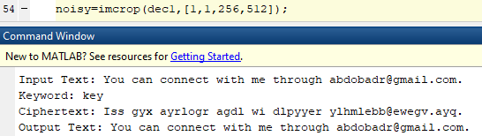
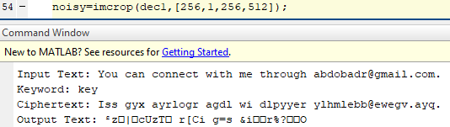
1. Crop Image
Crop half of image
Left Half
Crop half of image
Right Half

Slide 38
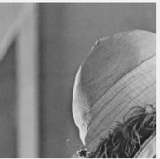
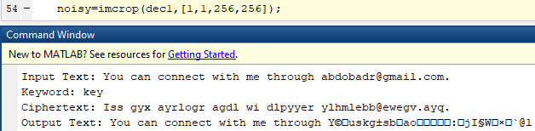
1. Crop Image
Crop quarter of image
There is problem, there isn’t any message in right half of image, so we modified this project to hide the same message in each quarter of image to receive most of message correctly

Slide 39
Modify Project
At Transmitter
At Receiver
Read Image, Enter Text message
Divide Image into 4 parts.and Encrypt each part
Encrypt Text message
Embed message into each image (we decrease the length of message to Extract correctly from quarter of image)
Combine each part of image with message into one image (Stego Image)
Decrypt Stego Image and send it
Divide Image into 4 parts.
Encrypt each part
Extract Encrypted Text message
from each Encrypted Image
Decrypt Text message
Get Text message

Slide 40
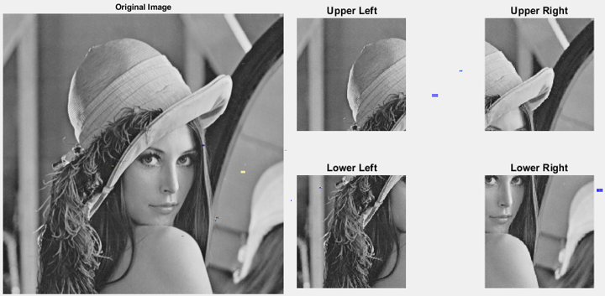
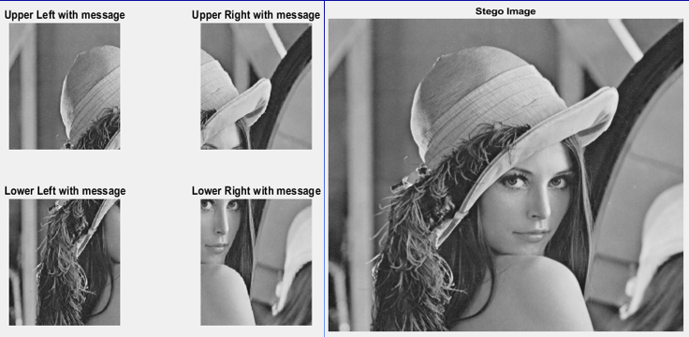
Modify Project

Slide 41

Results
Crop half of image
Right Half
Crop quarter of image

Slide 42
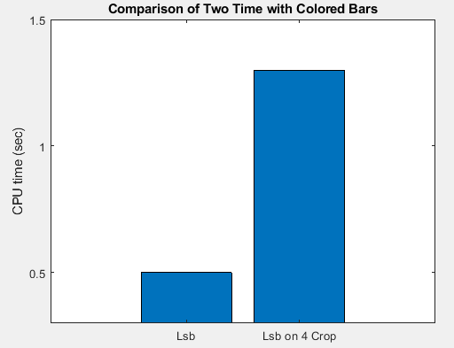
Results
 | LSB | LSB on 4 Crop
CPU Time | 0.5 sec | 1.3 sec
 | MSE | PSNR | Corr
Original and Stego | 0.002 | 171.8390 | 1
When increasing the number of crops means increasing the CPU time, MSE and decreasing the PSNR.

Slide 43
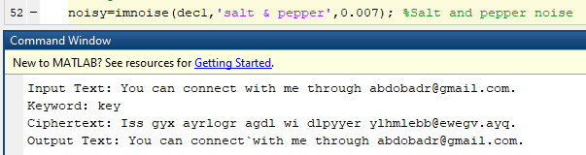
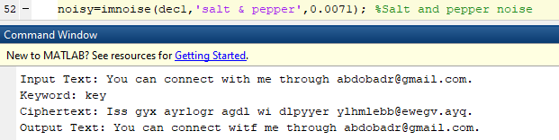
2. Salt & Pepper Noise
Add salt and pepper noise, with a noise density of 0.007 (Message doesn’t change)

Slide 44
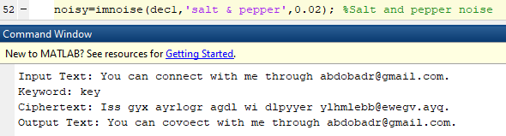
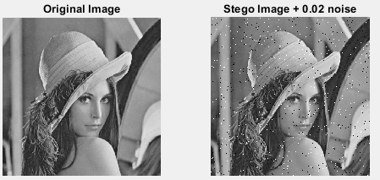
2. Salt & Pepper Noise
Add salt and pepper noise, with a noise density of 0.02, to the image

Slide 45
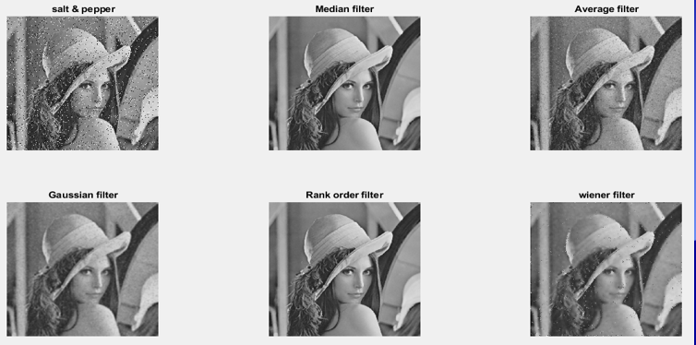
2. Salt & Pepper Noise
Different types of filters to remove salt & pepper noise

Slide 46
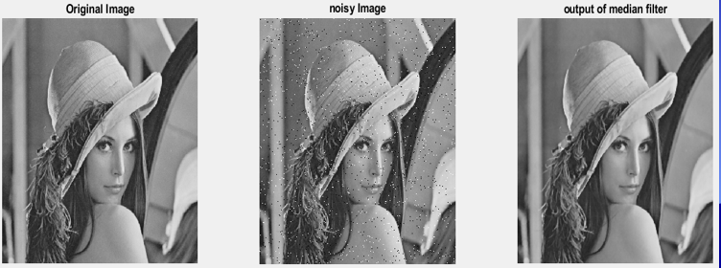
2. Salt & Pepper Noise
From this table
Median filter and Rank order filter are the best for filtering salt & pepper noise
Average filter is the worst for filtering salt & pepper noise
 | Median | Average | Gaussian | Rank order | Wiener
MSE between Original and Filter | 22.5757 | 17400 | 122.3875 | 22.5757 | 176.1603

Slide 47
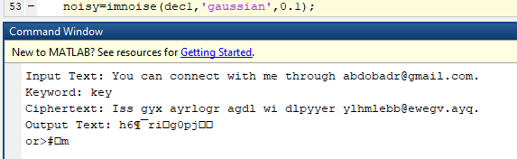
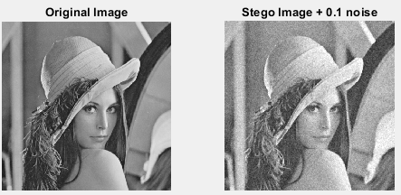
3. Gaussian Noise
Add Gaussian noise with 0.1

Slide 48
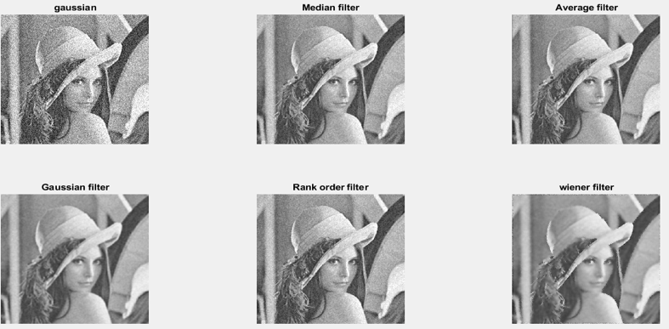
3. Gaussian Noise
Different types of filters to remove Gaussian noise

Slide 49
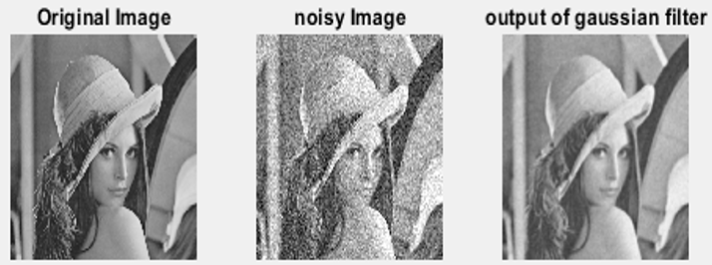
3. Gaussian Noise
From this table
Gaussian filter are the best for filtering gaussian noise
Average filter is the worst for filtering gaussian noise
 | Median | Average | Gaussian | Rank order | Wiener
MSE between Original and Filter | 781.4785 | 1751 | 735.7 | 781.4785 | 736.6217

Slide 50
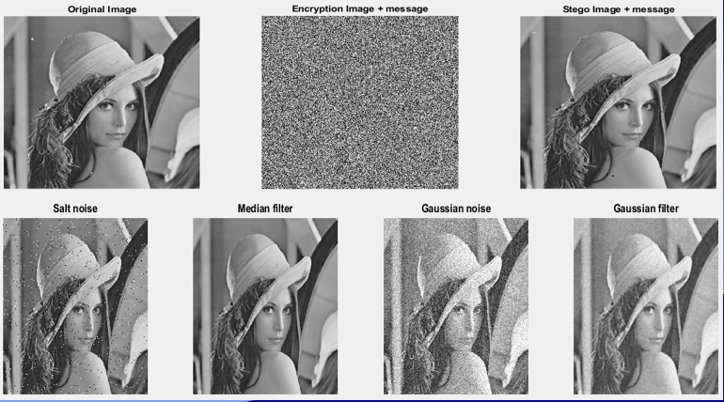
Summary for Salt & Pepper and Gaussian Noise

Slide 51
Chapter 3 & 4 Sound Steganography

Slide 52
Table of contents
01
02
03
04
05
06
Introduction to Sound
Sound steganography
Least Significant Bit (LSB)
Hiding Text into sound file
Hiding Image into sound file
Adding advanced features

Slide 53
Table of contents
07
Spread Spectrum

Slide 54
01
Introduction to sound

Slide 55
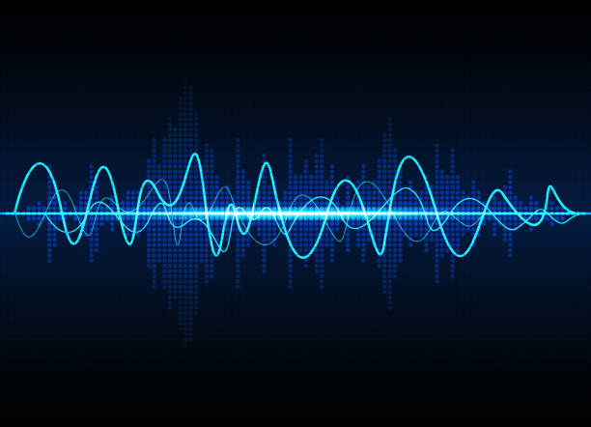
Introduction for sound
Sound is a form of energy that travels through waves, typically propagated through a medium such as air, water, or solids. It is a fundamental aspect of human experience and plays a crucial role in communication, perception, and the functioning of many technologies.
Properties of Sound
Wave Nature
Frequency
Amplitude
Wavelength

Slide 56
Introduction for sound
Production and Transmission of Sound
Source:
Produced by vibrating objects, creating disturbances. Examples: musical instruments, voices, mechanical devices.
Propagation:
Waves propagate by causing medium particles to vibrate. Speed varies by medium; in air, approximately 343 m/s.
Reception:
Detected by the ear, converted to electrical signals processed by the brain. Different organisms have varied hearing ranges.

Slide 57
02
Sound Steganography

Slide 58
Soud Steganography
Definition:
Sound steganography is the practice of hiding information within audio files in a way that remains undetectable to the human ear.
Fundamentals:
Conceals messages in audio files, maintaining the cover audio's perceptual integrity.
Digital audio is a series of samples representing sound wave amplitude over time.
Preferred formats for steganography: WAV (due to higher data capacity and uncompressed nature).

Slide 59
Soud Steganography
Techniques:
Least Significant Bit (LSB) Encoding:
Replaces the least significant bits of audio samples with hidden message bits.
Simple but vulnerable to noise and compression.
Phase Coding:
Modifies the phase of the audio signal to embed data.
Robust against compression but has lower data capacity.
Echo Hiding:
Embeds data by introducing an echo with specific delay and amplitude.
Robust but can affect audio quality if not managed well.
Spread Spectrum:
Distributes hidden data across the frequency spectrum using pseudorandom noise.
Highly robust but complex with low data embedding rate.

Slide 60
Soud Steganography
Applications:
Secure Communications:
Transmits confidential information covertly, often used in military and intelligence.
Digital Watermarking:
Embeds copyright or signature information to protect intellectual property.
Medical Data Hiding:
Embeds patient information into medical audio recordings for secure transmission.
Covert Channels:
Creates hidden communication channels within overt channels for security purposes.

Slide 61
03
Least Significant Bit (LSB)

Slide 62
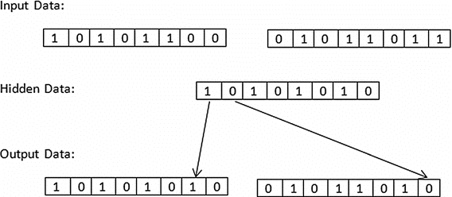
Least Significant Bit (LSB)
Introduction
Steganography: The practice of hiding information within another medium.
Least Significant Bit (LSB): A common and simple method of steganography used to hide data within images, audio, and video files.
Basic Concepts
Binary Representation: Digital media like images are made up of pixels, and each pixel's color can be represented in binary.
Least Significant Bit: The bit in the binary representation of a pixel value that has the least impact on the actual value (e.g., the rightmost bit in an 8-bit number).

Slide 63
Least Significant Bit (LSB)
How LSB Audio Steganography Works:
Audio Sample Representation:
An audio file is made up of a sequence of samples.
Each sample is a binary number. In a 16-bit audio file, each sample might look like this: 1010101010101010.
Embedding Data:
Replace the least significant bit of each audio sample with the bits of the secret data.
Example: If the secret data bit is 1, and an audio sample is 1010101010101010, it becomes 1010101010101011.
Extracting Data:
Read the least significant bit of each audio sample in sequence to reconstruct the hidden data.

Slide 64
Least Significant Bit (LSB)
Advantages of LSB Audio Steganography
Simplicity: Easy to implement and understand.
Minimal Distortion: Little to no perceptible change to the original audio, maintaining the cover medium's quality.
Limitations and Challenges
Vulnerability: Susceptible to attacks like noise addition, compression, or format conversion which can destroy hidden data.
Capacity: Limited by the size of the cover audio file. Only a small amount of data can be hidden.
Applications
Secure Communication: Hiding messages in audio files shared over public channels.
Digital Watermarking: Embedding copyright information within audio files to protect intellectual property.
Covert Channels: Secretly transmitting data to bypass censorship or surveillance.

Slide 65
04
Hiding Text into sound file

Slide 66
Hiding Text into sound file
Transmitter:
sound steganography transmitter that embeds a secret message into an audio signal and transmits it over a simulated wireless channel. The code incorporates basic audio steganography techniques using the Least Significant Bit (LSB) method and simulates a wireless channel with noise and fading effects.
Chanel:
Wireless channels experience impairments like Rayleigh fading, where signals reflect off multiple paths without direct line of sight, causing rapid amplitude and phase fluctuations. Additive White Gaussian Noise (AWGN) adds constant, Gaussian-distributed noise to signals, affecting all frequencies equally. Combined in a channel model, Rayleigh fading and AWGN cause signal amplitude variations and random noise, impacting signal reception and requiring techniques like diversity, channel estimation, and error correction for reliable communication.
Receiver:
the receiver part of a communication system designed to extract a secret message hidden within a received audio signal.

Slide 67
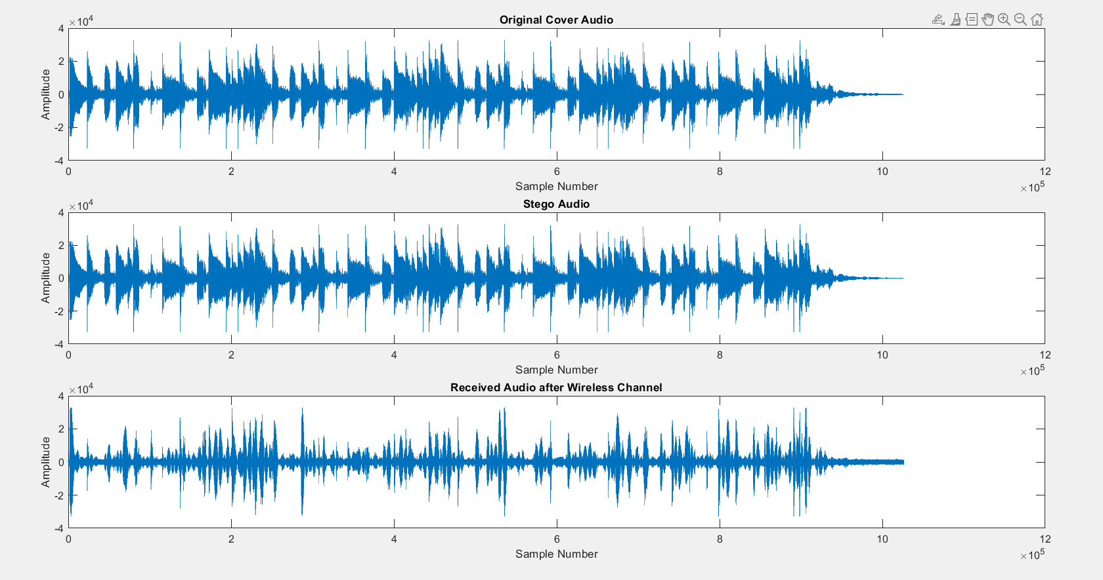
Hiding Text into sound file
Output of Transmitter

Slide 68
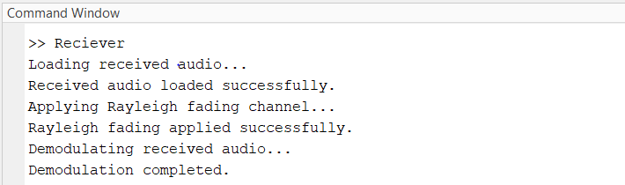
Hiding Text into sound file
Output of Receiver

Slide 69
05
Hiding Image into sound file

Slide 70
Hiding Image into sound file
Preparation
Image Selection: Choose an image and convert it into binary format, representing each pixel's color components (e.g., RGB) as binary sequences.
Sound File: Select a suitable sound file (e.g., WAV, MP3) that can accommodate the hidden image data without perceptible quality loss.
Binary Conversion
Image to Binary: Convert RGB values of each pixel into binary. For RGB images, this results in 24 bits (3 bytes) per pixel.
Embedding Process
Access Sound File: Programmatically access the sound file in your development environment.
LSB Replacement: Iterate through sound samples, replacing their least significant bits (LSBs) with bits from the binary image data.
Sequential Embedding: Embed image data sequentially into LSBs of successive sound samples to maximize hiding capacity while preserving sound quality.
Extraction: Develop or use a tool to extract the hidden image from the sound file, ensuring fidelity to the original image.

Slide 71
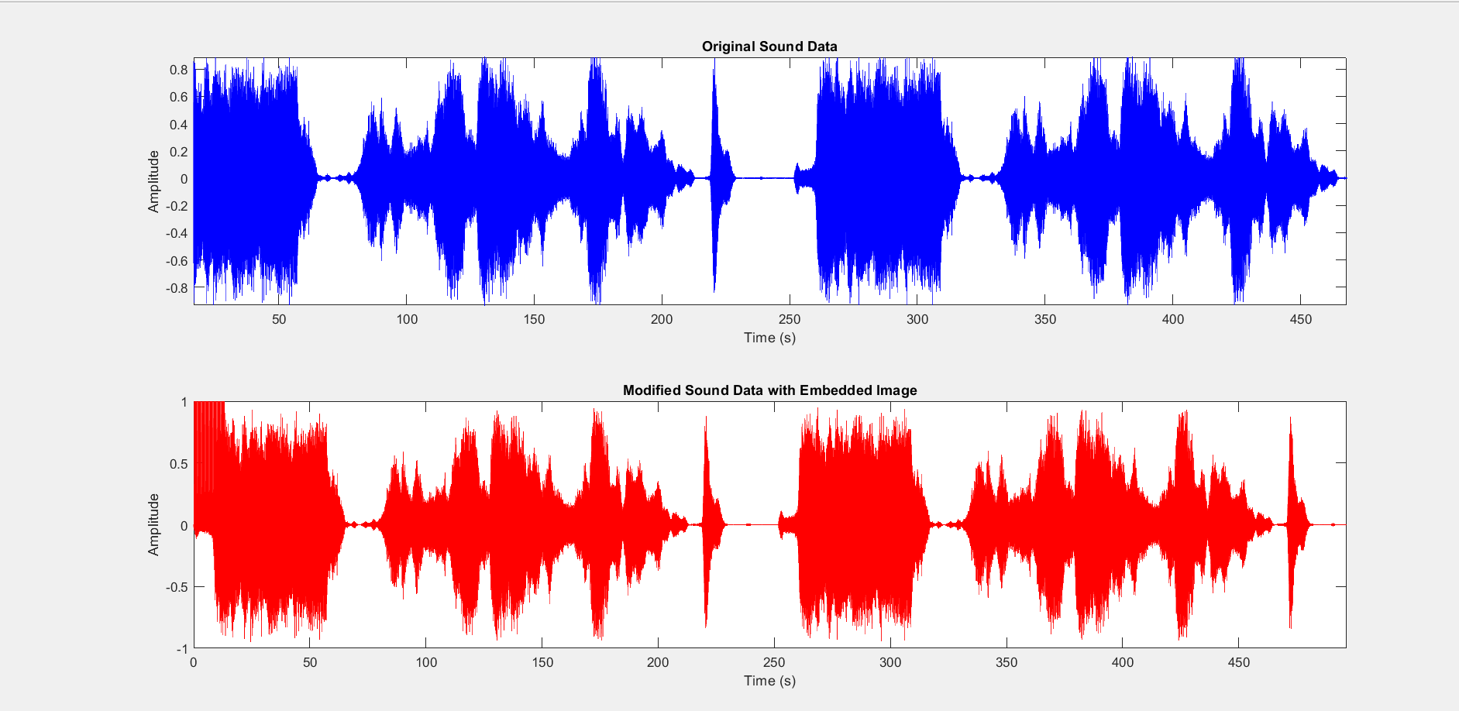
Hiding Image into sound file
The output graphs:

Slide 72
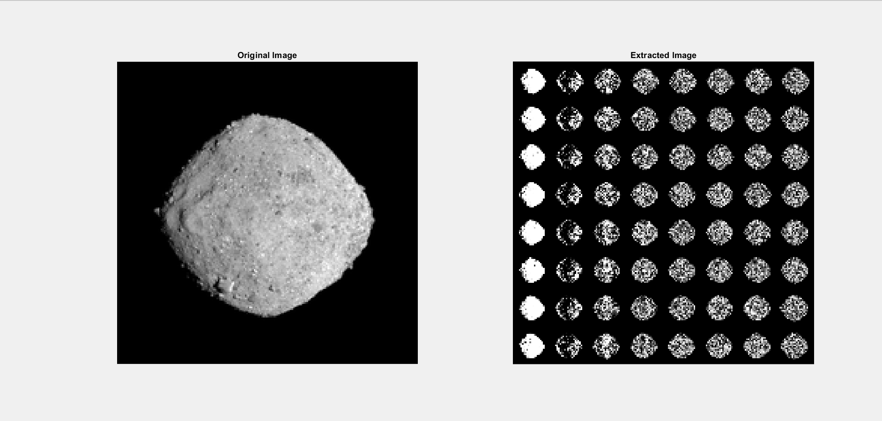
Hiding Image into sound file
The output graphs:

Slide 73
Hiding Image into sound file
Explanation of the graphs:
Original Sound Data Plot (Figure 1):
This plot shows the waveform of the sound file before any image embedding. It helps visualize the original amplitude and variation of the audio signal.
Modified Sound Data Plot (Figure 2):
After embedding the image data into the sound file using LSB steganography, this plot shows the modified waveform.
Differences between this plot and Figure 1 indicate where the image data has been embedded, affecting the LSBs of the sound samples.
Left Subplot: Shows the original image (imageData) that was embedded into the audio file.
Right Subplot: Shows the image (extractedImage) extracted from the modified sound file using the reverse LSB extraction process.

Slide 74
06
Adding advanced features

Slide 75
Adding advanced features
hiding an image in sound using optimized LSB (Least Significant Bit) steganography introduces several advanced features to enhance security, reliability, and adaptive embedding. Here are the key updates and their benefits:
hiding an image in sound using optimized LSB (Least Significant Bit) steganography introduces several advanced features to enhance security, reliability, and adaptive embedding. Here are the key updates and their benefits:
Image Compression:
Feature: Utilizes JPEG compression on the image before embedding.
Benefit: Reduces data size for efficient embedding, enhancing stealthiness.
Data Encryption:
Feature: Encrypts compressed image data with a stream cipher (XOR).
Benefit: Ensures embedded data remains secure and unreadable without the decryption key
3. Error Correction Codes (ECC):
Feature: Integrates Hamming Code (7,4) for error correction on encrypted data.
Benefit: Enhances reliability by enabling correction of embedding and extraction errors.

Slide 76
Adding advanced features
hiding an image in sound using optimized LSB (Least Significant Bit) steganography introduces several advanced features to enhance security, reliability, and adaptive embedding. Here are the key updates and their benefits:
4. Adaptive Embedding with Pseudorandom Positions:
Feature: Uses PRNG to select embedding positions based on sound sample amplitude.
Benefit: Minimizes detectability by embedding in high-amplitude regions, reducing perceptibility of changes.
5. Enhanced Visualization:
Feature: Provides detailed plots comparing original and modified sound data, and original and extracted images.
Benefit: Facilitates visual validation of embedding and extraction processes, ensuring integrity and success.

Slide 77
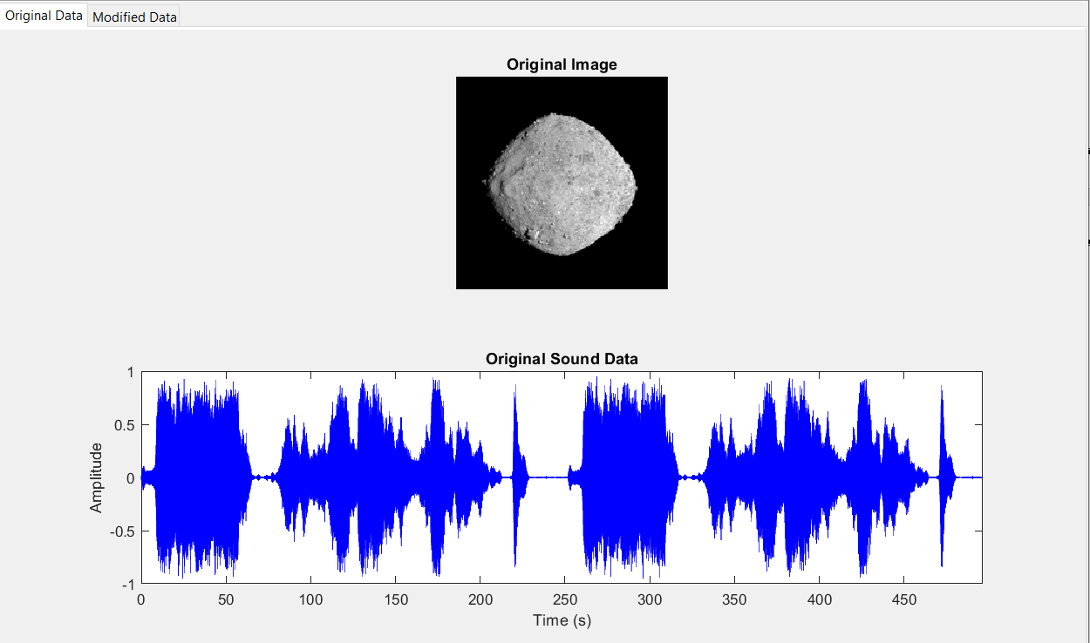
Adding advanced features
The Output graphs:

Slide 78
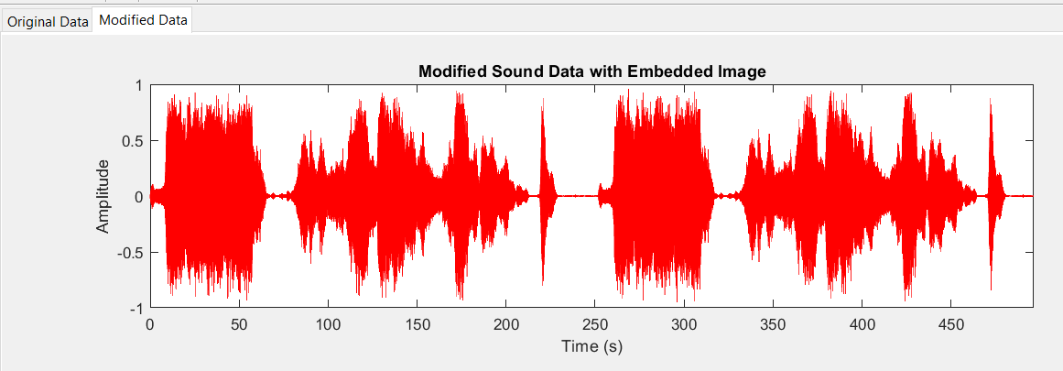
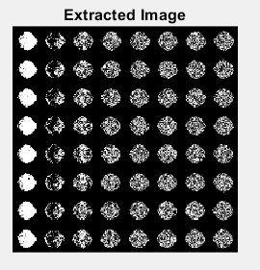
Adding advanced features
The Output graphs:

Slide 79
07
Spread Spectrum Technique

Slide 80
Fundamentals of Spread Spectrum Technique
1. Concept:
-Spread spectrum techniques spread the signal over a wide frequency band, much wider than the minimum bandwidth required to transmit the information.
-This spreading is achieved using a code that is independent of the original signal.
2. Advantages:
-Robustness -security -Low Detectability

Slide 81
Steps in Spread Spectrum Steganography:
1. Message Preparation 2.Spreading Code Generation
3.Modulation
-Direct Sequence Spread Spectrum (DSSS)
-Frequency Hopping Spread Spectrum (FHSS)
4.Embedding Process:
-Time Domain Embedding
-Frequency Domain Embedding
5.Transmission or Storage
Extraction Process:
1. Reception 2. Spreading Code Synchronization
3. Demodulation 4. Message Reconstruction

Slide 82
Applications and Considerations :
-Secure Communications: Transmitting confidential information covertly.
-Digital Watermarking: Protecting intellectual property by embedding ownership information.
-Covert Channels: Creating hidden communication channels within overt audio transmissions.

Slide 83
Chapter 5 Chaotic Code: Generation and Properties

Slide 84
Table of contents
01
02
03
Chaos theory
The fundamental principles of chaos theory
Mathematical Background

Slide 85
01
Chaos theory

Slide 86
-Definition of chaos theory
-Definition of chaos theory relevance to cryptography

Slide 87
02
The fundamental principles of chaos theory

Slide 88
1. Sensitivity to Initial Conditions
2. Nonlinearity
3. Unpredictability
4. Attractors
5. Determinism

Slide 89
03
mathematical background

Slide 90
-Chaos and Phase/State Spaces
-Lyapunov exponents

Slide 91
Chapter 6 Applications of Chaotic Code in Image Encryption

Slide 92
Table of contents
01
02
03
04
Chaos in Cryptography
Chaotic Encryption Algorithms
Chaotic Encryption - Image
Hardware Implementation

Slide 93
01
Chaos in Cryptography

Slide 94
Chaos in Cryptography
High Sensitivity to Initial Conditions
Pseudo-Randomness
Deterministic yet Unpredictable
Complexity and Nonlinearity

Slide 95
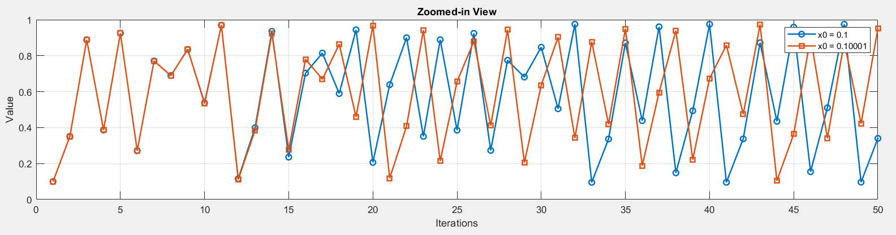
High Sensitivity to Initial Conditions
Key Sensitivity
Enhanced Security
Robustness

Slide 96
Pseudo-Randomness
Pseudo-randomness in chaotic systems refers to the generation of sequences that appear random, although they are generated by deterministic rules.
Random Key Generation
Secure Stream Ciphers
Initialization Vectors (IVs)

Slide 97
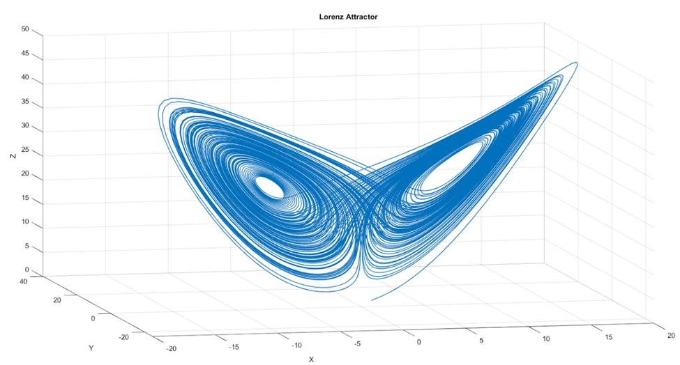
Deterministic yet Unpredictable
Chaotic systems are deterministic, meaning their future behaviour is fully determined by their initial conditions and rules, yet they appear unpredictable due to their complex dynamics.
Repeatability
Unpredictability

Slide 98
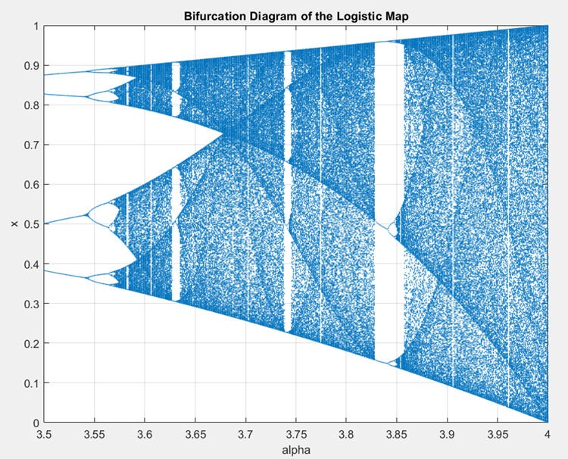
Complexity and Nonlinearity
Chaotic systems exhibit complex and nonlinear behaviour, meaning their evolution cannot be described by simple linear equations.
Enhanced Complexity
Resistance to Linear
Attacks

Slide 99
02
Chaotic Encryption Algorithms

Slide 100
Chaotic Encryption Algorithms
Shuffling
Substitution
Key Generation

Slide 101
Shuffling and Substitution
Chaotic encryption algorithms for images commonly use two main techniques:
Shuffling
Substitution

Slide 102
Shuffling
Shuffling involves rearranging the positions of elements within the data based on a chaotic sequence.

Slide 103
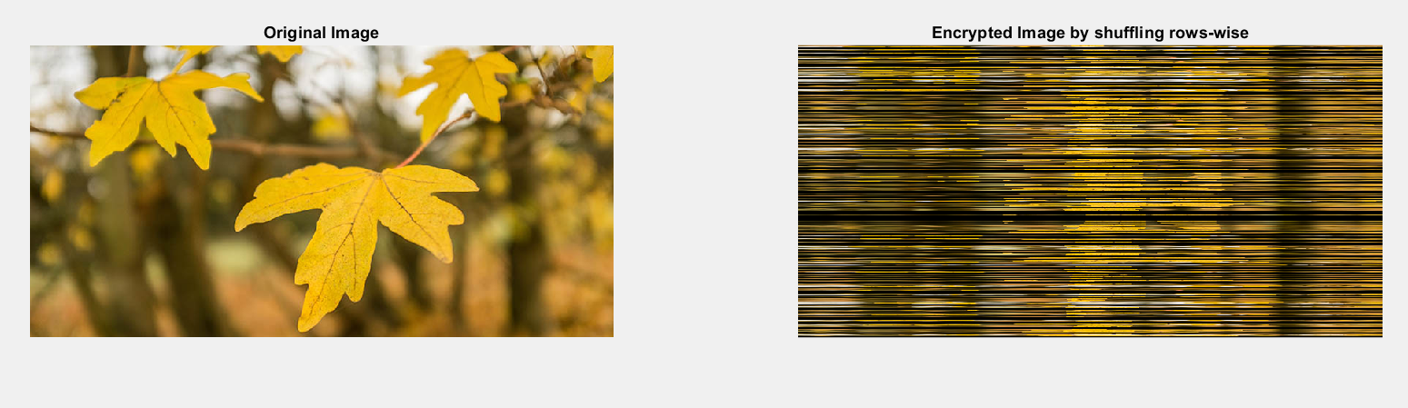
Shuffling Techniques
Row-wise: It involves rearranging the rows of pixel values in the image, while keeping the columns intact.

Slide 104

Shuffling Techniques
Column-wise: It entails rearranging the columns of pixel values while maintaining the integrity of the rows.

Slide 105

Shuffling Techniques
Pixel-wise: Involves rearranging individual pixels randomly throughout the image. This method offers enhanced distortion.

Slide 106
Substitution
Substitution involves replacing the elements of the data with other elements according to a predefined scheme, typically based on chaotic sequences.

Slide 107

Substitution
The colors (pixel values) are altered, but the overall shape and structure of the image remain recognizable to the naked eye.

Slide 108
Key Generation for Image Encryption
Key generation in chaotic encryption algorithms leverages the pseudo-randomness and sensitivity of chaotic maps.
Chaotic Maps
Initial Conditions and Parameters
Generation of Pseudo-Random Sequences
Key Derivation

Slide 109
03
Chaotic Encryption – Image

Slide 110
Chaotic Encryption Algorithms
Image Encryption and Decryption
Decrypting Using Incorrect Key
Encrypting Using Non-optimal Parameter

Slide 111

Encrypted Image

Slide 112

Decrypted Image

Slide 113
Encryption and Decryption Algorithm
At Transmitter
At Receiver
Initialization: Initializes the encrypted image and generates a chaotic sequence.
Shuffling pixel-wise: The pixel values in each channel of the image are shuffled based on the chaotic sequence.
Substitution: The shuffled pixel values are then substituted using a bitwise XOR operation with the key.
Initialization: initializes the decrypted image and generates the same chaotic sequence using the same key.
Substitution: The encrypted pixel values are first XORed with the key to reverse the substitution process.
Shuffling pixel-wise: The pixels are then shuffled in reverse order using the chaotic sequence, restoring the original positions of the pixels to reconstruct the original image.

Slide 114

Decryption Using Incorrect Key

Slide 115

Encrypting Using Non-optimal Parameter

Slide 116
06
Hardware Implementation for Generating Chaotic Code

Slide 117
Circuit used to generate chaotic code:
Chua's circuit is a simple electronic circuit that exhibits a wide range of chaotic behaviors. It typically consists of the following components:
1. Inductor (L)
2. Capacitors (C1 and C2)
3. Resistors (R)
4. Chua's Diode (a nonlinear resistor)

Slide 118
-Circuit Components and Configuration:
1. Inductor (L): This stores energy in a magnetic field.
2. Capacitors (C1 and C2): These store energy in an electric field.
3. Resistors (R): These dissipate energy.
4. Chua's Diode: This is a nonlinear resistor that can be constructed using operational amplifiers and diodes. It provides the nonlinearity necessary for chaotic behavior.

Slide 119
Connect the Components:
1-Connect the inductor (L) in series with a resistor (R).
2-Connect this series combination to a capacitor (C1).
3-Connect another capacitor (C2) in parallel with the first capacitor (C1).
4-Connect the nonlinear resistor (Chua's Diode) across the capacitors.

Slide 120

After Connecting ( Standard form of the Chua's circuit )

Slide 121

Characteristic of Chua's diode
So like we see it’s non-linear

Slide 122

The relation between the voltage of capacitors and inductor with time

Slide 123

Pictured is a graph of the non-periodic orbit in Chua’s circuit, each dimension representing the voltage or current in a particular component of the circuit

